Slide 1
HERE’S YOUR SIGN

Slide 2
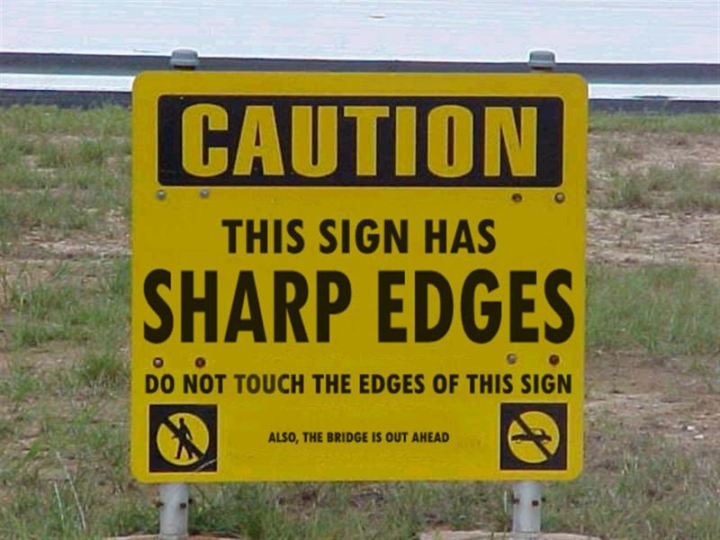
Some signs are ridiculous!

Slide 3
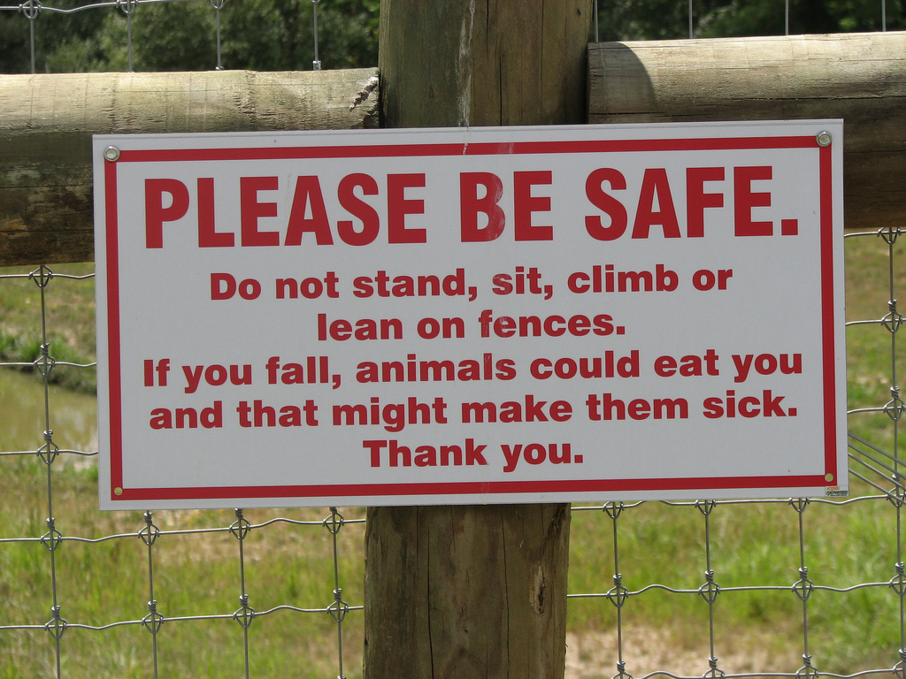
Some signs are ridiculous!

Slide 4
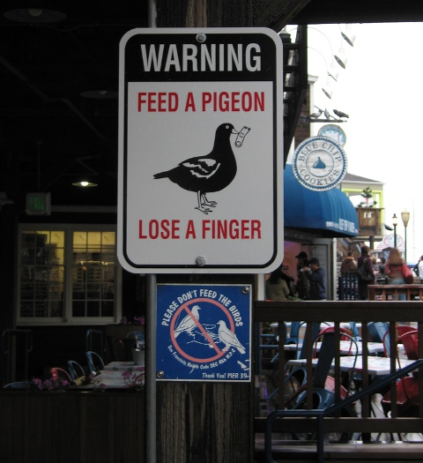
Some signs are silly!

Slide 5
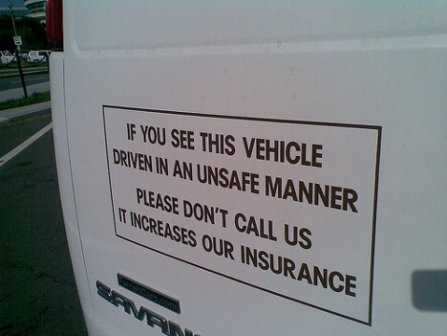
Some signs are funny!

Slide 6
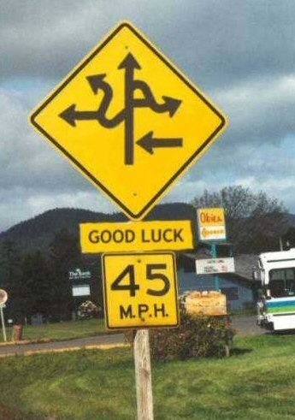
Some signs are funny!

Slide 7
Some signs are just plain offensive!

Slide 9
“Enter by the narrow gate; for wide is the gate and broad is the way that leads to destruction, and there are many who go in by it. ¹⁴ Because narrow is the gate and difficult is the way which leads to life, and there are few who find it.
Matthew 7: 13-14.

Slide 10
“Enter by the narrow gate; for wide is the gate and broad is the way that leads to destruction, and there are many who go in by it. ¹⁴ Because narrow is the gate and difficult is the way which leads to life, and there are few who find it.
Matthew 7: 13-14.

Slide 11
Then Saul, still breathing threats and murder against the disciples of the Lord, went to the high priest ² and asked letters from him to the synagogues of Damascus, so that if he found any who were of the Way, whether men or women, he might bring them bound to Jerusalem.
Acts 9: 1-2.

Slide 12
Then Saul, still breathing threats and murder against the disciples of the Lord, went to the high priest ² and asked letters from him to the synagogues of Damascus, so that if he found any who were of the Way, whether men or women, he might bring them bound to Jerusalem.
Acts 9: 1-2.

Slide 13
SIGNS WE MIGHT SEE IN
“THE WAY”

Slide 14
Jesus said to him, “I am the way, the truth, and the life. No one comes to the Father except through Me.
John 14: 6.

Slide 15
Then Peter, filled with the Holy Spirit, said to them, “Rulers of the people and elders of Israel: ⁹ If we this day are judged for a good deed done to a helpless man, by what means he has been made well, ¹⁰ let it be known to you all, and to all the people of Israel, that by the name of Jesus Christ of Nazareth, whom you crucified, whom God raised from the dead, by Him this man stands here before you whole. ¹¹ This is the ‘stone which was rejected by you builders, which has become the chief cornerstone.’ ¹² Nor is there salvation in any other, for there is no other name under heaven given among men by which we must be saved.”
Acts 4: 8-12.

Slide 16
Then Jesus spoke to them again, saying, “I am the light of the world. He who follows Me shall not walk in darkness, but have the light of life.”
John 8: 12.

Slide 17
Jesus answered and said to her, “Whoever drinks of this water will thirst again, ¹⁴ but whoever drinks of the water that I shall give him will never thirst. But the water that I shall give him will become in him a fountain of water springing up into everlasting life.”
John 4: 13-14.

Slide 18
Jesus said to her, “I am the resurrection and the life. He who believes in Me, though he may die, he shall live. ²⁶ And whoever lives and believes in Me shall never die. Do you believe this?” ²⁷ She said to Him, “Yes, Lord, I believe that You are the Christ, the Son of God, who is to come into the world.”
John 11: 25-27.

Slide 19
For I am not ashamed of the gospel of Christ, for it is the power of God to salvation for everyone who believes, for the Jew first and also for the Greek.
Romans 1: 16.

Slide 20
See then that you walk circumspectly, not as fools but as wise, ¹⁶ redeeming the time, because the days are evil. ¹⁷ Therefore do not be unwise, but understand what the will of the Lord is.
Ephesians 5: 16-17.
YOUR TIME

Slide 21
Then He said to another, “Follow Me.” But he said, “Lord, let me first go and bury my father.” ⁶⁰ Jesus said to him, “Let the dead bury their own dead, but you go and preach the kingdom of God.”
Luke 9: 59-60.
YOUR TIME

Slide 22
‘For to everyone who has, more will be given, and he will have abundance; but from him who does not have, even what he has will be taken away. ³⁰ And cast the unprofitable servant into the outer darkness. There will be weeping and gnashing of teeth.’
Matthew 25: 29-30.
YOUR TALENTS

Slide 23
He who loves father or mother more than Me is not worthy of Me. And he who loves son or daughter more than Me is not worthy of Me.
Matthew 10: 37.
YOUR ALLEGIENCE

Slide 24
He who finds his life will lose it, and he who loses his life for My sake will find it.
Matthew 10: 39.
YOUR LIFE

Slide 25
I beseech you therefore, brethren, by the mercies of God, that you present your bodies a living sacrifice, holy, acceptable to God, which is your reasonable service.
Romans 12: 1.
YOUR LIFE

Slide 26
But what things were gain to me, these I have counted loss for Christ. ⁸ Yet indeed I also count all things loss for the excellence of the knowledge of Christ Jesus my Lord, for whom I have suffered the loss of all things, and count them as rubbish, that I may gain Christ
Philippians 3: 7-8.
YOUR LIFE

Slide 27
What shall we say then? Shall we continue in sin that grace may abound? ² Certainly not! How shall we who died to sin live any longer in it?
Romans 6: 1-2.
SINNING

Slide 28
My little children, these things I write to you, so that you may not sin. And if anyone sins, we have an Advocate with the Father, Jesus Christ the righteous.
1 John 2: 1.
SINNING

Slide 29
Whoever has been born of God does not sin, for His seed remains in him; and he cannot sin, because he has been born of God.
1 John 3: 9.
SINNING

Slide 30
Only be strong and very courageous, that you may observe to do according to all the law which Moses My servant commanded you; do not turn from it to the right hand or to the left, that you may prosper wherever you go.
Joshua 1: 7.

Slide 31
Only be strong and very courageous, that you may observe to do according to all the law which Moses My servant commanded you; do not turn from it to the right hand or to the left, that you may prosper wherever you go.
Joshua 1: 7.

Slide 32
You shall not add to the word which I command you, nor take from it, that you may keep the commandments of the LORD your God which I command you.
Deuteronomy 4: 2.
NO RIGHT TURN

Slide 33
You shall not add to the word which I command you, nor take from it, that you may keep the commandments of the LORD your God which I command you.
Deuteronomy 4: 2.
NO RIGHT TURN

Slide 34
Every word of God is pure; He is a shield to those who put their trust in Him. ⁶ Do not add to His words, Lest He rebuke you, and you be found a liar.
Proverbs 30: 5-6.
NO RIGHT TURN

Slide 35
Every word of God is pure; He is a shield to those who put their trust in Him. ⁶ Do not add to His words, Lest He rebuke you, and you be found a liar.
Proverbs 30: 5-6.
NO RIGHT TURN

Slide 36
For I testify to everyone who hears the words of the prophecy of this book: If anyone adds to these things, God will add to him the plagues that are written in this book; 19 and if anyone takes away from the words of the book of this prophecy, God shall take away his part from the Book of Life, from the holy city, and from the things which are written in this book.
Revelation 22: 18-19.
NO RIGHT TURN

Slide 37
For I testify to everyone who hears the words of the prophecy of this book: If anyone adds to these things, God will add to him the plagues that are written in this book; 19 and if anyone takes away from the words of the book of this prophecy, God shall take away his part from the Book of Life, from the holy city, and from the things which are written in this book.
Revelation 22: 18-19.
NO RIGHT TURN

Slide 38
You shall not add to the word which I command you, nor take from it, that you may keep the commandments of the LORD your God which I command you.
Deuteronomy 4: 2.
NO LEFT
TURN

Slide 39
You shall not add to the word which I command you, nor take from it, that you may keep the commandments of the LORD your God which I command you.
Deuteronomy 4: 2.
NO LEFT
TURN

Slide 40
For I testify to everyone who hears the words of the prophecy of this book: If anyone adds to these things, God will add to him the plagues that are written in this book; 19 and if anyone takes away from the words of the book of this prophecy, God shall take away his part from the Book of Life, from the holy city, and from the things which are written in this book.
Revelation 22: 18-19.
NO LEFT
TURN

Slide 41
For I testify to everyone who hears the words of the prophecy of this book: If anyone adds to these things, God will add to him the plagues that are written in this book; 19 and if anyone takes away from the words of the book of this prophecy, God shall take away his part from the Book of Life, from the holy city, and from the things which are written in this book.
Revelation 22: 18-19.
NO LEFT
TURN

Slide 42
Only be strong and very courageous, that you may observe to do according to all the law which Moses My servant commanded you; do not turn from it to the right hand or to the left, that you may prosper wherever you go.
Joshua 1: 7.

Slide 43
Only be strong and very courageous, that you may observe to do according to all the law which Moses My servant commanded you; do not turn from it to the right hand or to the left, that you may prosper wherever you go.
Joshua 1: 7.

Slide 44
But he who looks into the perfect law of liberty and continues in it, and is not a forgetful hearer but a doer of the work, this one will be blessed in what he does.
James 1: 25.

Slide 45
But he who looks into the perfect law of liberty and continues in it, and is not a forgetful hearer but a doer of the work, this one will be blessed in what he does.
James 1: 25.

Slide 46
Conclusion.
Are you in the ?
Are you trying to sinning?
Have you begun to your life to God?
Have you stayed on the path?

